Slide 1
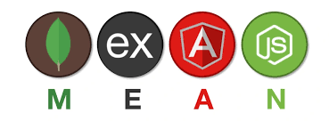
Introduction to Web Development and the MEAN Stack
Overview of web development
Introduction to the MEAN stack
Setting up the development environment

Slide 2
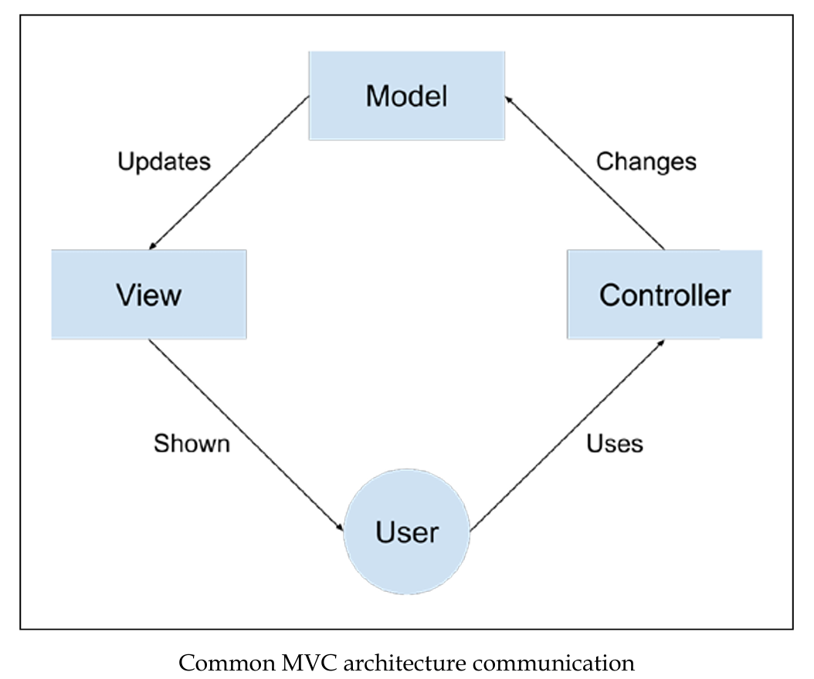
Overview of web development
Three-tier web application development
MVC separates an application into Model, View, and Controller.
View manages the visual interface and user interaction.
Controller handles system/user events and instructs Model and View.
Model manages data, updates state, and provides information when requested.
Each component focuses on its own task to keep the architecture organized.

Slide 3
The evolution of JavaScript
JavaScript began as a client-side language for browsers.
Evolving web apps led to new tools and libraries for easier development.
Faster browsers improved JavaScript performance.
Google’s V8 engine (2008) boosted speed and enabled JavaScript outside browsers.
Node.js introduced non-blocking I/O and a modular ecosystem.
MongoDB (2009) offered scalable, flexible NoSQL storage.
AngularJS brought structured frontend development with advanced features.
Open-source growth accelerated JavaScript innovation.
JavaScript became full-stack across frontend, backend, and databases (MEAN stack).

Slide 4
Introduction to the MEAN stack
MEAN stands for MongoDB, Express, AngularJS, and Node.js.It uses JavaScript across all parts of the application.
Benefits include:
  Single language throughout.
  Supports MVC structure.
  No need for data serialization/deserialization (uses JSON).
MEAN is a powerful full-stack solution but integrating its components may introduce scaling and architecture challenges.

Slide 5
In our syllabus, we will cover challenges such as:
Connecting MEAN stack components.
Choosing appropriate Node.js modules.
Maintaining MVC structure in JavaScript.
Modeling data in a schema-less JSON database.
Implementing user authentication.
Using non-blocking architecture for real-time apps.
Testing MEAN applications.
Selecting suitable development tools.

Slide 6
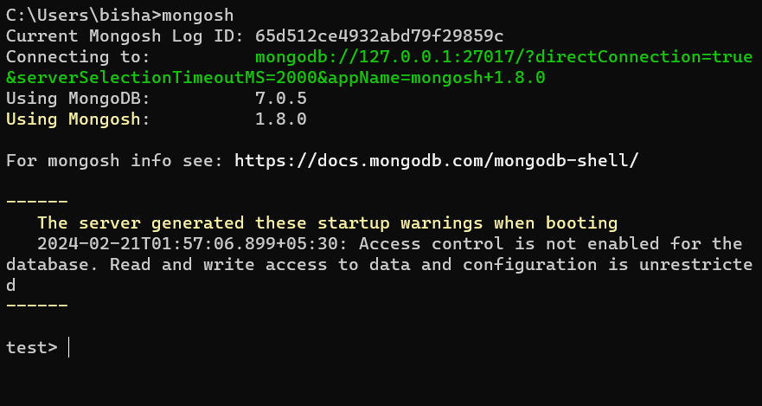
Setting up the development environment
Installing MongoDB
MongoDB: The World’s Leading Modern Database | MongoDB
Installing MongoDB on Windows
Running MongoDB manually
Running MongoDB as a Windows Service
Installing MongoDB on Mac OS X and Linux
Installing MongoDB from binaries
Install MongoDB using a package manager
Using the MongoDB shell

Slide 7
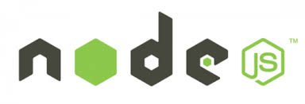
Installing Node.js
Node.js — Run JavaScript Everywhere
Installing
Installing Node.js on Windows
Installing Node.js on Mac OS X
Installing Node.js on Linux
Running Node.js

Slide 8
Introducing NPM
NPM Overview
NPM installs, updates, and removes Node.js modules.
Comes with Node.js by default.
Includes a registry (to browse/download) and a CLI (to manage packages).
Installation Modes
Local (default): Installs inside project node_modules. npm install express
Global: Installs system-wide (for CLI tools). npm install -g express
Install / Remove / Update
Install latest: npm install <package>
Install version: npm install <package>@<version>
Uninstall: npm uninstall <package>
Update: npm update <package>
Notes
Packages listed at https://www.npmjs.com/

Slide 9
Managing Dependencies with package.json
package.json helps manage your app’s dependencies and metadata (name, version, author, etc.).
{
"name": "MEAN",
"version": "0.0.1",
"dependencies": {
"express": "latest",
"grunt": "latest"
}
}
name and version are required.
Use specific versions instead of "latest" to avoid compatibility issues.
Installing Dependencies
npm install
npm update
Adding New Packages
npm install express --save

